Slide 1


Cliffhanger: Scaling Performance Cliffs in Web Memory Caches
Asaf Cidon, Assaf Eisenman,
Mohammad Alizadeh and Sachin Katti

Slide 2







Memory Caches are Essential to Web-scale Application Performance

Slide 3
Memory Cache Hit Rate Drives Performance
Memcached most widely used cache in large data centers
Small improvements are important, especially when hit rates are high
+1% cache hit-rate → 35% speedup
  Old latency: 374 µs
  New latency: 278 µs
  Facebook study: Atikoglu et al [Sigmetrics ’12]
Notes:
Speedup instead of latency reduction

Slide 4
Memory Caches not Optimized for Maximizing Hit Rate
Does not optimize for hit rate across different request sizes and applications
  Cache greedily assigns memory to different request sizes and applications
  Memory assignment remains static

Slide 5
Memcached’s Static Cache Allocation
Memcached Server
64 byte
slab
Item 1
35 bytes
128 byte
slab
256 byte
slab
512 byte
slab
1 KB
slab
Notes:
When something comes in and there’s memory left, you keep allocating memory to it, as long as there’s memory
Memory is assigned to slab classes, each of which have a separate LRU queue

Slide 6
Memcached’s Static Cache Allocation
Memcached Server
1
64 byte
slab
Item 1
35 bytes

Slide 7
Memcached’s Static Cache Allocation
Memcached Server
8
7
6
5
4
3
2
1
64 byte
slab
Item 2
60 bytes
…
Item 8
60 bytes

Slide 8
Memcached’s Static Cache Allocation
Memcached Server
8
7
6
5
4
3
2
1
64 byte
slab
Item 9
100 bytes
9
128 byte
slab
Item 13
378 bytes
13
512 byte
slab
2 KB
slab

Slide 9
Memcached’s Static Cache Allocation
Memcached Server
8
7
6
5
4
3
2
1
64 byte
slab
Item 10
100 bytes
Item 12
100 bytes
9
128 byte
slab
…
Item 14
433 bytes
…
Item 20
510 bytes
13
512 byte
slab

Slide 10
Memcached’s Static Cache Allocation
Memcached Server
8
7
6
5
4
3
2
1
64 byte
slab
Item 10
100 bytes
Item 12
100 bytes
12
11
10
9
128 byte
slab
…
Item 14
433 bytes
…
Item 20
510 bytes
20
19
18
17
512 byte
slab
16
15
14
13

Slide 11
Memcached’s Static Cache Allocation
Memcached Server
8
7
6
5
4
3
2
1
64 byte
slab
Item 9
120 bytes
12
11
10
9
128 byte
slab
20
19
18
17
512 byte
slab
16
15
14
13

Slide 12
Memcached’s Static Cache Allocation
Memcached Server
8
7
6
5
4
3
2
1
64 byte
slab
Item 9
120 bytes
9
12
11
10
128 byte
slab
20
19
18
17
512 byte
slab
16
15
14
13

Slide 13
Memcached’s Static Cache Allocation
Memcached Server
8
7
6
5
4
3
2
1
64 byte
slab
Item 21
43 bytes
9
12
11
10
128 byte
slab
20
19
18
17
512 byte
slab
16
15
14
13
2 KB
slab
Notes:
Unfortunately there’s no new pages to allocate to it. So now the size of the LRU queue is essentially fixed

Slide 14
Memcached’s Static Cache Allocation
Memcached Server
8
7
6
5
4
3
2
1
64 byte
slab
Item 21
43 bytes
9
12
11
10
128 byte
slab
20
19
18
17
512 byte
slab
16
15
14
13
2 KB
slab

Slide 15
Memcached’s Static Cache Allocation
Memcached Server
21
8
7
6
5
4
3
2
64 byte
slab
9
12
11
10
128 byte
slab
256 byte
slab
20
19
18
17
512 byte
slab
16
15
14
13
1 KB
slab
2 KB
slab

Slide 16
Memcached’s Static Cache Allocation
Memcached Server
21
8
7
6
5
4
3
2
64 byte
slab
Item 1
35 bytes
9
12
11
10
128 byte
slab
256 byte
slab
20
19
18
17
512 byte
slab
16
15
14
13
1 KB
slab
2 KB
slab

Slide 17
Problems with Memcached Static Cache Allocation
Greedy page allocation favors large slab classes
“Slab calcification” when request sizes change over time
Can we do better?

Slide 18

Understanding Memcached Workloads With MemCachier Traces
Weeklong trace taken from MemCachier
  490 applications on 30 Memcached servers
  Each application has its own pages

Slide 19
Profiling Hit Rate Curves
138
21
Hit: position 5
Hit: position 1
Miss
8
53
1
22
138
LRU Queue
Stack distances:
5
1
∞

Slide 20
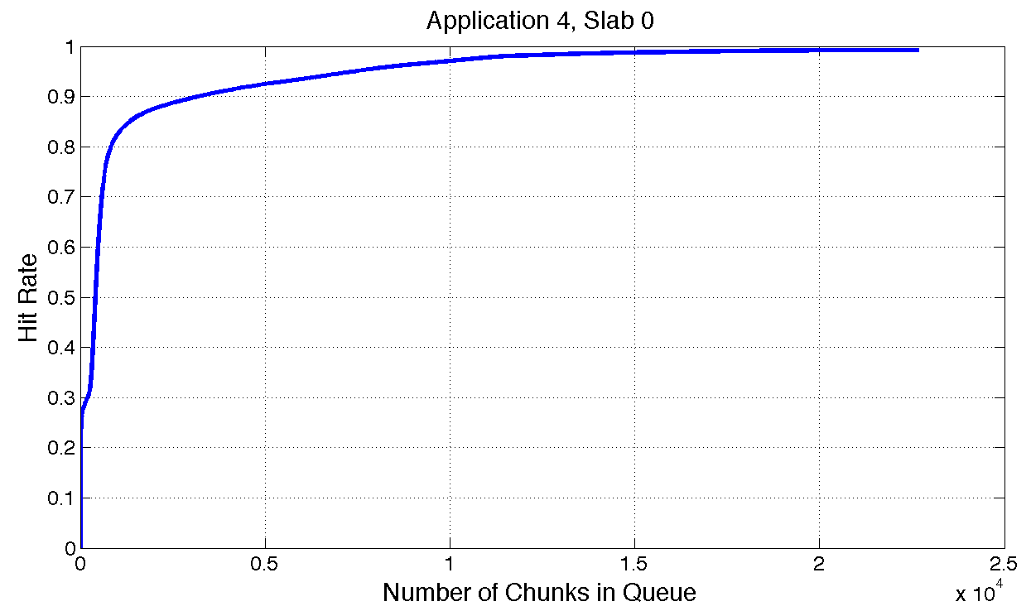
Hit Rate Curve Profiling

Slide 21
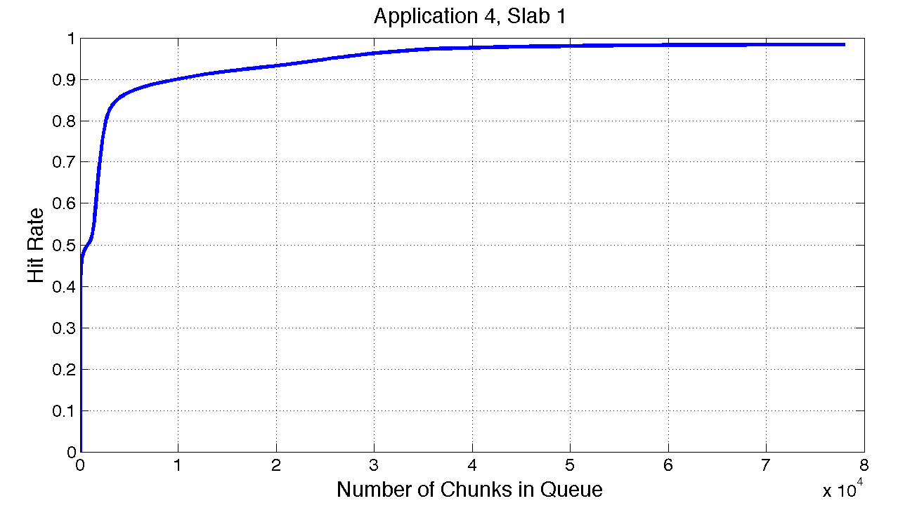
Optimizing Hit Rate Curves

Slide 22
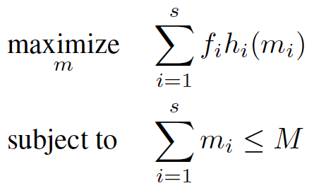
Memory Allocation Solver Using Hit-rate Curves
ƒ – frequency of requests
h – hit-rate of requests
m – memory allocated to slab class
M – memory allocated to application
Notes:
Strawman solution

Slide 23
Solver Output
Allocate 1178 Items
Allocate 41381 Items

Slide 24
Solver is Expensive and Not Dynamic
Solver is expensive
  Requires estimating stack distances for each curve
  Requires centralized solver
Solver is static
  How frequently should we optimize?
Instead of optimizing entire hit rate curve, we can optimize incrementally
  Estimate local gradient for each curve
  Increase memory for curve with highest gradient

Slide 25
Using Shadow Queues to Estimate Local Gradient
Queue 1
8
53
1
22
Physical Queue
Shadow Queue
Queue 2
9
87
Physical Queue
Shadow Queue
 | Credits
Queue 1 | 0
Queue 2 | 0
Notes:
Imagine you have multiple queues, here I have two. Now I need to figure out how much I need to allocate to each queue. I add the shadow queue, and I will use this shadow queue to estimate the derivative or marginal improvement if I were to add a little bit of more memory to each queue. And I use hits in the shadow queue to figure out which queue I add memory to and which I don’t

Slide 26
Using Shadow Queues to Estimate Local Gradient
Queue 1
8
53
1
22
Physical Queue
Shadow Queue
23
Queue 2
9
87
Physical Queue
Shadow Queue
 | Credits
Queue 1 | 0
Queue 2 | 0

Slide 27
Using Shadow Queues to Estimate Local Gradient
Queue 1
23
8
53
1
22
Miss
Physical Queue
Shadow Queue
23
Queue 2
9
87
Physical Queue
Shadow Queue
 | Credits
Queue 1 | 0
Queue 2 | 0

Slide 28
Using Shadow Queues to Estimate Local Gradient
Queue 1
23
8
53
1
22
Physical Queue
Shadow Queue
22
Queue 2
9
87
Physical Queue
Shadow Queue
 | Credits
Queue 1 | 0
Queue 2 | 0

Slide 29
Using Shadow Queues to Estimate Local Gradient
Queue 1
23
8
53
1
22
Shadow Queue Hit
Physical Queue
Shadow Queue
22
Queue 2
9
87
Physical Queue
Shadow Queue
 | Credits
Queue 1 | 1
Queue 2 | -1

Slide 30
Using Shadow Queues to Estimate Local Gradient
Queue 1
22
23
8
53
1
Physical Queue
Shadow Queue
22
Queue 2
9
87
Physical Queue
Shadow Queue
 | Credits
Queue 1 | 1
Queue 2 | -1

Slide 31
Using Shadow Queues to Estimate Local Gradient
Queue 1
22
23
8
53
1
Physical Queue
Shadow Queue
1
Queue 2
9
87
Physical Queue
Shadow Queue
 | Credits
Queue 1 | 1
Queue 2 | -1

Slide 32
Using Shadow Queues to Estimate Local Gradient
Queue 1
22
23
8
53
1
Shadow Queue Hit
Physical Queue
Shadow Queue
1
Queue 2
9
87
Physical Queue
Shadow Queue
 | Credits
Queue 1 | 2
Queue 2 | -2

Slide 33
Using Shadow Queues to Estimate Local Gradient
Queue 1
1
22
23
8
53
Physical Queue
Shadow Queue
1
Queue 2
9
87
Physical Queue
Shadow Queue
 | Credits
Queue 1 | 2
Queue 2 | -2
Resize Queues

Slide 34
Using Shadow Queues to Estimate Local Gradient
Queue 1
1
22
23
8
53
Physical Queue
Shadow Queue
Queue 2
9
87
87
Physical Queue
Shadow Queue
 | Credits
Queue 1 | 0
Queue 2 | 0

Slide 35
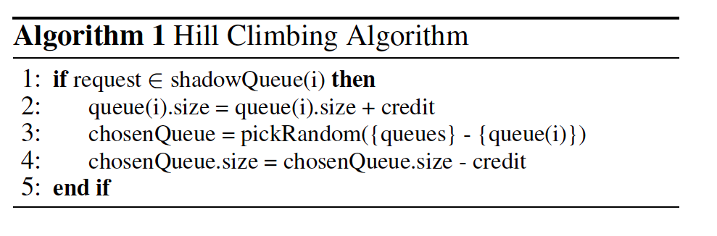
Algorithm 1: Hill-climbing

Slide 36
Algorithm 1: Hill-climbing
Approximates optimization
At optimal memory allocation:
  Credit increase rate = credit decrease rate for each queue
Notes:
It turns out this simple algorithm if all the hit rate curves are nice and concave, it will actually converge to the same solution to solve the optimization problem.
The rate of adding memory to a queue and subtracting memory from it will need to be equal in the optimal scheme, which is the optimality condition for the optimization problem

Slide 37
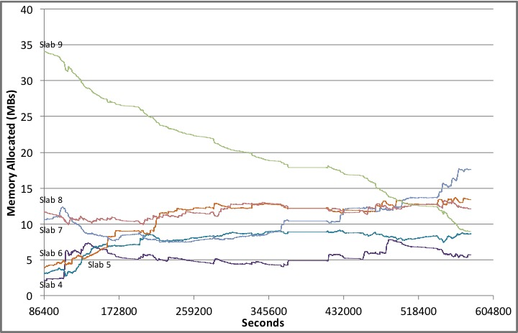
Hill Climbing Algorithm Over Time (Application 5)

Slide 38
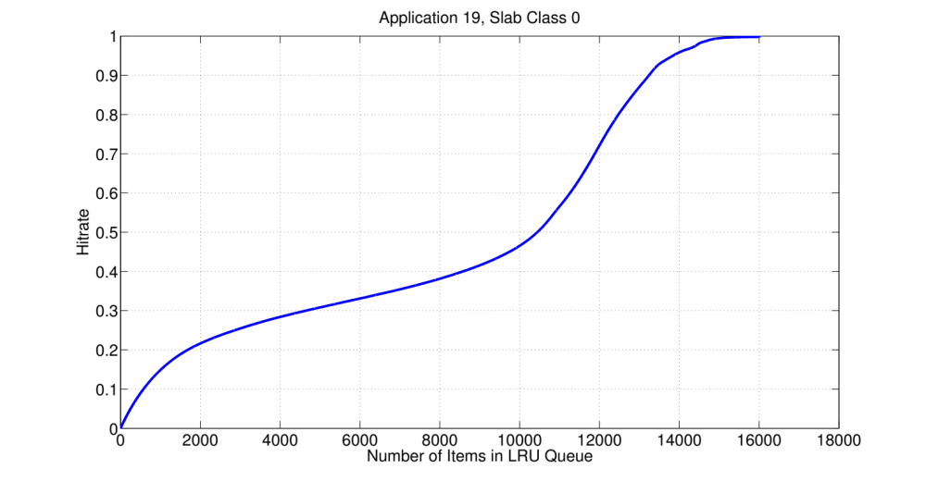
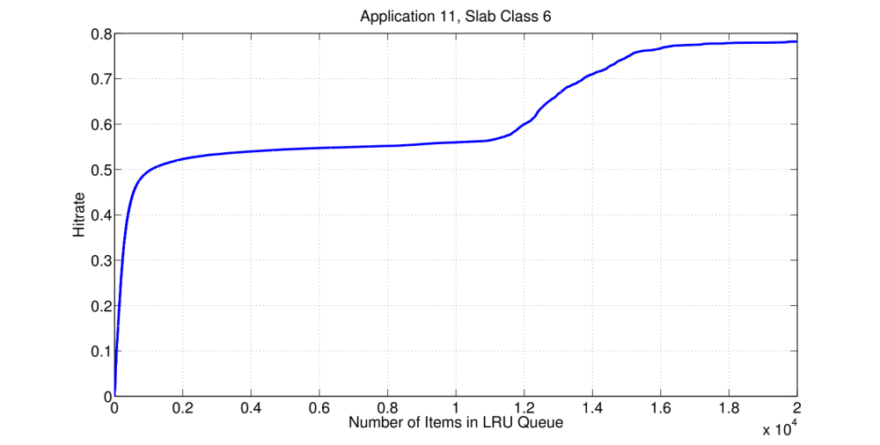
Performance Cliffs Hurt Local Optimization

Slide 39
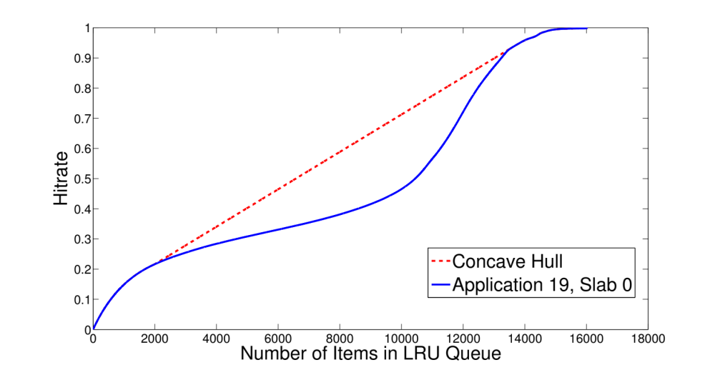
Talus: Simulating Two Queues

Slide 40
Talus: Simulating Two Queues
Simulated Right Queue
13,000 items
48% of Requests
957 Items
8000 Items
7043
Items
Simulated Left Queue
2000 items
52% of Requests
Notes:
Let’s say you have this point of 8000, and you want to achieve this point.
Take a queue with 8000, , show you get the bottom point
Take 8000, split into two

Slide 41
Algorithm 2: Cliff Scaling
Talus requires knowledge of hitrate curve
  Where the performance cliff starts and ends
Algorithm 2 locally estimates where the performance cliff starts and ends
  Estimate the second derivative with shadow queues

Slide 42
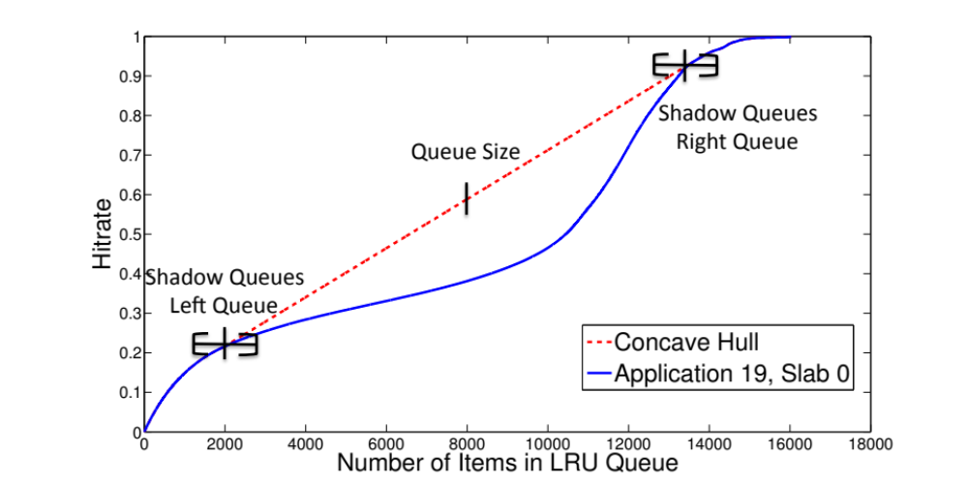
Estimating Second Derivative with Shadow Queues
Notes:
If we take a shadow queue and split it into two

Slide 43
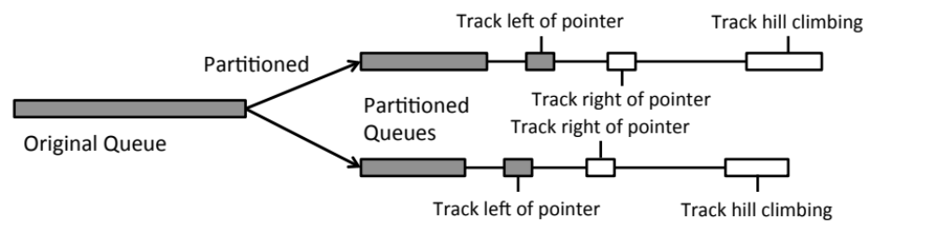
Cliffhanger Runs Both Algorithms in Parallel
Algorithm 1: incrementally optimize memory across queues
  Across slab classes
  Across applications
Algorithm 2: scales performance cliffs

Slide 44
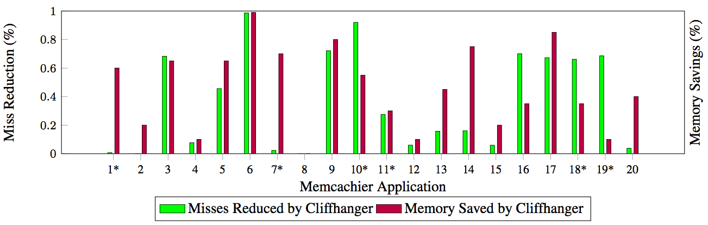
Cliffhanger Reduces Misses and Can Save Memory
Average misses reduced: 36.7%
Average potential memory savings: 45%

Slide 45
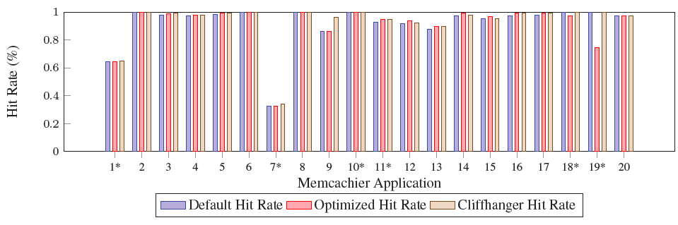
Cliffhanger Outperforms Default and Optimized Schemes
Average Cliffhanger hit rate increase: 1.2%

Slide 46
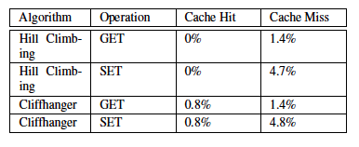
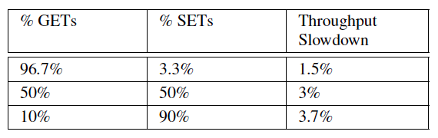
Low Overheads
Latency overhead:
Throughput overhead:
Memory overhead: 500KB for each application

Slide 47
Summary
Web-scale applications heavily reliant on memory cache hit rate
But, existing cache allocation is not optimized for max hit rate
Cliffhanger’s incremental dynamic cache allocation using shadow queues maximizes hit rates and addresses performance cliffs

Slide 48
Appendix

Slide 49
Related Work
Cache partitioning for performance cliffs
  Talus: Beckmann et al [HPCA ‘15]
Optimizing memory allocation across applications based on hitrate curves
  Mimir: Saemundsson et al [SOCC ‘14]
Rebalancing slabs to reduce slab calcification
  Twitter: Rajashekhar et al [Twitter blog ’12]
  Facebook: Nishtala et al [NSDI ’13]
Optimizing Memcached multi-threaded performance
  MICA: Lim et al [NSDI ’14]

Slide 50
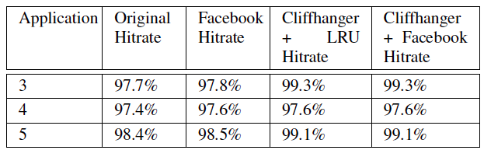
Comparison with “Facebook LRU”

Slide 51
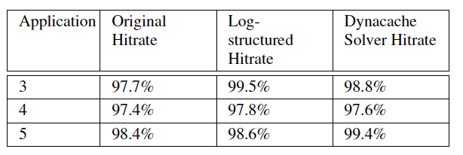
Log Structured Memory is Still Greedy

Slide 52
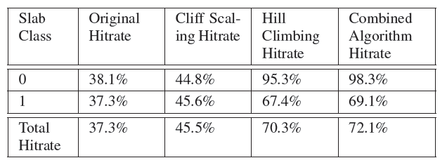
Algorithms are Complementary (Memcachier’s Application 19)

Slide 53
Why Do Performance Cliffs Occur?
Applications issues requests 1, 2, 3, 4, 5
Queue size = 4
  0% hitrate

Slide 54
Intuition Behind Talus
2 queues with size = 2
  First queue gets 1, 2, 3
  Second queue gets 4, 5
  First queue hitrate: 0%
  Second queue hitrate: 100%
  Overall hitrate: 40%

Slide 55
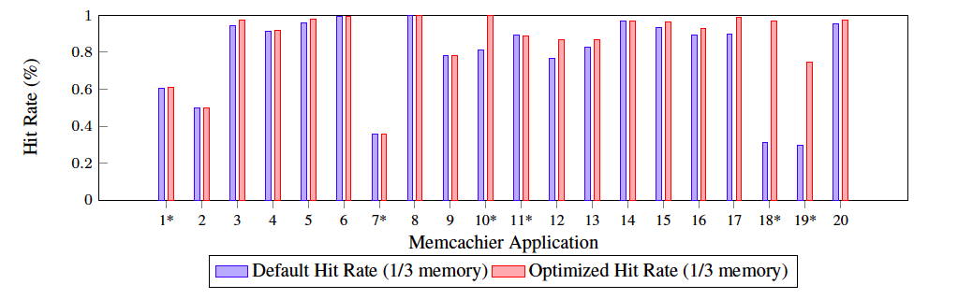
Solver’s Potential for Improvement

Slide 56
Solver’s Potential for Improvement
+19% Hit Rate
+66% Hit Rate
+45% Hit Rate

